Slide 1
Regular Expression with Python

Slide 2
Regex (regular expression)
Meta Characters
Special Characters
Search for a match something more than a direct match.
Special Sequence
Escaping Characters
These characters search for a match something specific characters

Slide 3
re
regular expression

Slide 4
syntax for matching string
Command | Syntax | Description
match | re.match | This method tries to match the compiled pattern only at the beginning of the string.
search | re.search | It tries to match the pattern at any location of the string and not just at the beginning.
findall | re.findall | It returns a list with all the non-overlapping occurrences of a pattern and not the MatchObject.
compile | re.compile | Compile regular expression pattern. Transforming it into bytecode. Bytecode is an intermediary language. Returning the pattern object.

Slide 5
import re

Slide 6
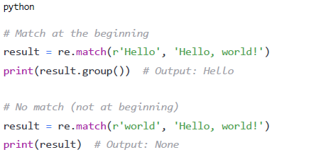
re.match()
re.match(pattern, string, flags=0)
Attempts to match pattern at the beginning of string
Return Match object or None

Slide 7

re.search()
re.search(pattern, string, flags=0)
Searches for first occurrence of pattern anywhere in string
Return Match object or None

Slide 8
re.match() vs re.search()
re.match() : pattern must be start of the string
re.search() : pattern mush be anywhere of the string

Slide 9
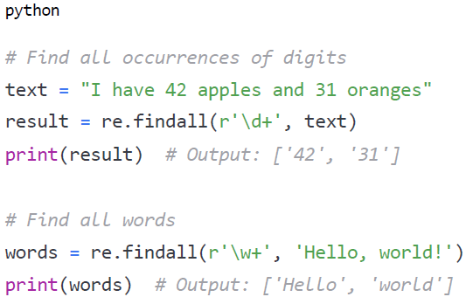
re.findall()
re.findall(pattern, string, flags=0)
Returns all non-overlapping matches as a list of strings

Slide 10
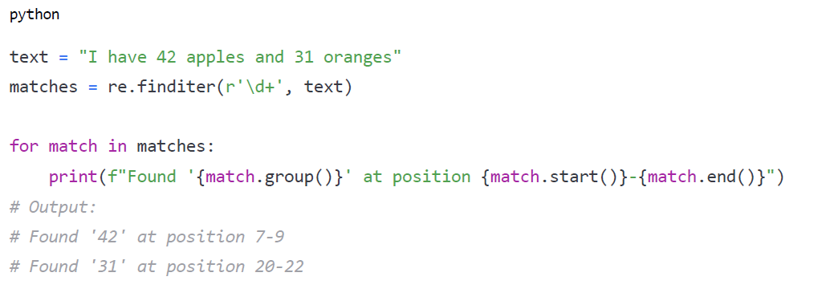
re.finditer()
re.finditer(pattern, string, flags=0)
Like findall(), but returns an iterator of Match objects
Provides more information about each match

Slide 11
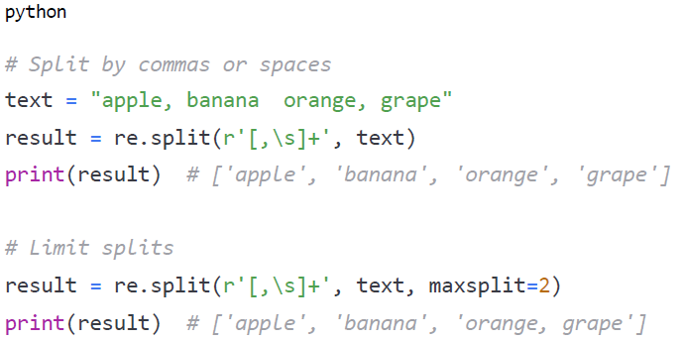
re.split()
re.finditer(pattern, string, maxsplit=0, flags=0)
Split string by occurrence of pattern
Returns list of substrings
Optional maxsplit parameter limits number of splits

Slide 12
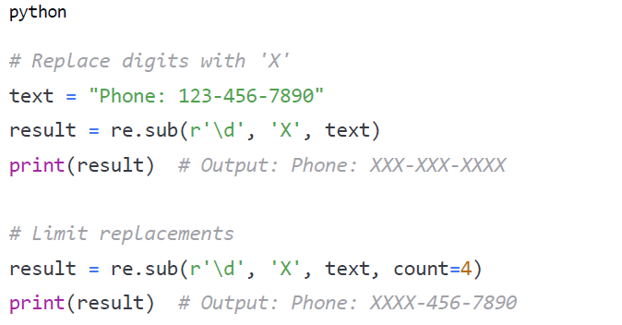
re.sub()
re.sub(pattern, repl, string, count=0, flags=0)
Replaces occurrences of pattern with replacement string
Optional count parameter limit number of replacements.

Slide 13
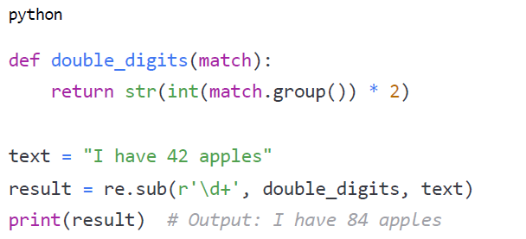
re.sub() with function
re.sub(pattern, repl, string, count=0, flags=0)
Replacement can be a function that receives match object
Function must return replacement string

Slide 14
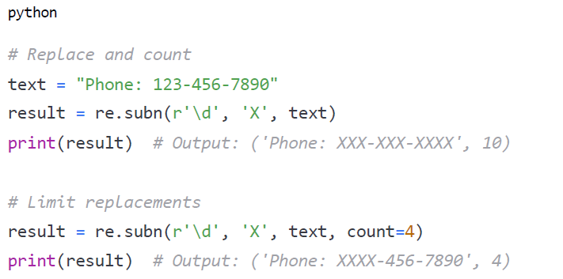
re.subn()
re.subn(pattern, repl, string, count=0, flags=0)
Like sub(), but returns tuple: (new string, number of replacements)

Slide 15
MatchObject
MatchObject
Returned by match(), search(), and finditer()
Contains information about the match
Key methods:
group() - Returns matched text
groups() - Returns tuple of all groups
groupdict() - Returns dictionary of named groups
start(), end(), span() - Position information
expand() - Template substitution

Slide 16
re

Slide 17
Meta Characters
Characters | Description | Example | Match
| | Either or | “cat|hello
. | Any character (one) except new line | “he..lo” | Match the characters between e and l in the example
{ } | Exactly the specified number of occurrence | “he.{2}o”
* | Zero or more occurrence | “he.*o” | Find the word that starts with 'he,' followed by zero or more characters, and ends with ‘o. Eg: hello, hero, Helico
+ | one or more occurrence | “he.+o” | Find the word that starts with 'he,' followed by one or more characters, and ends with ‘o. Eg: hello, hero, Helico
? | Zero or one occurrence | “he.?o” | Eg. Hero
( ) | Capture and group
[ ] | A set of characters | “[a-z]” | abcdefghijklmnopqrstuvwxyz
^ | Starts with | “^hello” | Starts with hello
$ | Ends with | “world$” | Sentence ends with World
\ | Signals a special sequence (Can also be used to escape special characters) | “\d” | Match all integers in string

Slide 18
Special Sequences
Characters | Description | Example
\w | Returns a match where the string contains any word characters (characters from a to z, digits from 0-9, and the underscore _ characters) | “\w”
\W | Returns a match where the string DOES NOT contain any word characters | “\W”
\b | Returns a match where the specified characters are at the beginning or at the end of a word. | r“\bello” r”ello\b”
\B | Returns a match where the specified characters are present, but NOT as the beginning of a word (or at the end) | r“\Bello” r”ello\B”
\d | Returns a match where the string contains digits (number from 0-9) | “\d”
\D | Returns a match where the string DOES NOT contains digits | “\D”
\s | Returns a match where the string contains a white space characters | “\s”
\S | Return a match where the string DOES NOT contains a white space characters | “\S”
\A | Returns a match if specified characters are at the beginning of the string. | r“\AThe”
\Z | Returns a match if the specified characters are at the end of the string | “Spain\Z”

Slide 19
Example String
Once upon a time in a colorful town, a young coder started learning Regex. He practiced on words like apple, Banana, and cherry. His teacher said, ‘Numbers like 12345 and 42 are easy to match using special patterns.’ So, he tried a regex that found any digit. One day, he saw a sign that said Start here and wondered if regex could match words that start with something. Later, he found a note that ended with End here. and thought about matching the end of a sentence. He also learned that . could match any character, like in ‘cat’ or ‘cet’. When testing, he noticed some words like hero, helicopter, he, and heo, which made him curious about zero or more characters in between letters. He wrote a regex that could match one or more characters after a pattern. Another tricky test was checking if color and colour could be matched with an optional letter. He then practiced with words like ‘hellooo’ to match exactly two ‘o’s. Finally, he saw two people falling and staying, so he tested an OR condition. His final challenge was repeating words like ‘repeated repeated’ and checking if regex could capture and group them correctly. In the end, he mastered Regex and built powerful search tools!

Slide 20
/<pattern>/
In python
r”<pattern>”

Slide 21
/cat/
match the pattern “cat”
Return which range this pattern exists

Slide 22
Example
The quick brown fox jumps over the lazy dog. This is outside (this is inside)
SNO | QUESTION | ANSWER
1 | Match the string “fox” and provide its range | 16-19
2 | How many times does “is” appear in above string ? | 4
3 | Match the pattern “(this is inside)” and provide its range | 61-77

Slide 23
Meta Characters
Characters | Description | Example | Match
| | Either or | “cat|hello
. | Any character (one) except new line | “he..lo” | Match the characters between e and l in the example
{ } | Exactly the specified number of occurrence | “he.{2}o”
* | Zero or more occurrence | “he.*o” | Find the word that starts with 'he,' followed by zero or more characters, and ends with ‘o. Eg: hello, hero, Helico
+ | one or more occurrence | “he.+o” | Find the word that starts with 'he,' followed by one or more characters, and ends with ‘o. Eg: hello, hero, Helico
? | Zero or one occurrence | “he.?o” | Eg. Hero
( ) | Capture and group
[ ] | A set of characters | “[a-z]” | abcdefghijklmnopqrstuvwxyz
^ | Starts with | “^hello” | Starts with hello
$ | Ends with | “world$” | Sentence ends with World
\ | Signals a special sequence (Can also be used to escape special characters) | “\d” | Match all integers in string

Slide 24
/cat|cherry/
| (pipe)
match the pattern “cat” or “cherry”
Return which range this pattern exists

Slide 25
Exercise
The sun rises in the east and sets in the west. Birds sing in the morning or evening.
SNO | QUESTION | PATTERN
1 | Write a regex pattern to match either “sun” or “moon” in the string | sun|moon
2 | Find a regex pattern to match either “east” or “west” | east|west
3 | Write a regex pattern to match either “morning” or “evening” | morning|evening
4 | Create a regex pattern to match either “rises”, “sets”, or “sing” | rises|sets|sing
5 | Find regex pattern to match either “The” or “Birds” | The|Birds

Slide 26
Meta Characters
Characters | Description | Example | Match
| | Either or | “cat|hello
. | Any character (one) except new line | “he..lo” | Match the characters between e and l in the example
{ } | Exactly the specified number of occurrence | “he.{2}o”
* | Zero or more occurrence | “he.*o” | Find the word that starts with 'he,' followed by zero or more characters, and ends with ‘o. Eg: hello, hero, Helico
+ | one or more occurrence | “he.+o” | Find the word that starts with 'he,' followed by one or more characters, and ends with ‘o. Eg: hello, hero, Helico
? | Zero or one occurrence | “he.?o” | Eg. Hero
( ) | Capture and group
[ ] | A set of characters | “[a-z]” | abcdefghijklmnopqrstuvwxyz
^ | Starts with | “^hello” | Starts with hello
$ | Ends with | “world$” | Sentence ends with World
\ | Signals a special sequence (Can also be used to escape special characters) | “\d” | Match all integers in string

Slide 27
/c.t/
. (dot)
Matches any character (one) expect new line
cat
cbt
cct
cdt
cet
cft
…
czt
cAt
cBt
cCt
cDt
cEt
cFt
…
cZt
c0t
c1t
c2t
c3t
c4t
c5t
…
c9t
c~t
c!t
c@t
c#t
c$t
c%t
…
Alphabets
Special characters
Numbers
Escape characters (except new line [\n])
match the pattern “c<any character>t”
Return which range this pattern exists

Slide 28
Warning
Dot (.) is very powerful metacharacter that can create problem if it is not use properly.

Slide 29
Meta Characters
Characters | Description | Example | Match
| | Either or | “cat|hello
. | Any character (one) except new line | “he..lo” | Match the characters between e and l in the example
[ ] | A set of characters | “[a-z]” | abcdefghijklmnopqrstuvwxyz
{ } | Exactly the specified number of occurrence | “he.{2}o”
* | Zero or more occurrence | “he.*o” | Find the word that starts with 'he,' followed by zero or more characters, and ends with ‘o. Eg: hello, hero, Helico
+ | one or more occurrence | “he.+o” | Find the word that starts with 'he,' followed by one or more characters, and ends with ‘o. Eg: hello, hero, Helico
? | Zero or one occurrence | “he.?o” | Eg. Hero
( ) | Capture and group
^ | Starts with | “^hello” | Starts with hello
$ | Ends with | “world$” | Sentence ends with World
\ | Signals a special sequence (Can also be used to escape special characters) | “\d” | Match all integers in string

Slide 30
[ ] Character set or character classes
Allows to define a character that will match if any of the defined characters on the set is present.
Element | Description
[cs] | / licen[cs]e/
[0-9] | Matches anything between 0 and 9 (0, 1, 2, 3, 4, 5, 6, 7, 8, 9)
[a-z] | Matches anything between a and z (a, b, c, d, …, z)
[A-Z] | Matches anything between A and Z (A, B, C, D …, Z)
[0-9a-zA-Z] | Any lowercase or uppercase alphanumeric character
licence
license

Slide 31
caret (^) Negation of range
Allows to define a character that will match if any of the defined characters on the set is present.
Element | Description
[^0-9] | Will match anything that is not a digit
[^a-z] | Will match anything that is not a lowercase alphabets
[^A-Z] | Will match anything that is not a uppercase alphabets
[^0-9a-zA-Z] | Will match anything that is not lowercase or uppercase alphanumeric character

Slide 32
Exercise Question
Contact Information:
John Doe - john.doe@example.com - (555) 123-4567
Mary Smith - mary_smith@email.net - 555.987.6543
Tom Johnson - tom-johnson@company.org - (555)246-8910
Sarah Brown - sarah@brown.co.uk - +1-555-369-7412
Mike Wilson - mike.wilson@subdomain.example.edu - 555 741 0258
SNO | QUESTION | PATTERN
1 | Write a regular expression using character sets ([]) to match any single vowel (a, e, i, o, u) in the text.
2 | Write a regular expression using pipe (|) to match either "John" or "Tom" in the text.
3 | Write a regular expression using caret (^) inside character sets to match any single character that is NOT a digit in the text.
4 | Write a regular expression to match either "com" or "net" in the email domains.
5 | Write a regular expression using character sets to match any single digit in the phone numbers.
6 | Write a regular expression using the dot (.) to match any character between 'T' and 'm' in "Tom".
7 | Write a regular expression using character sets to match any single uppercase letter in the text.
8 | Write a regular expression using caret (^) inside character sets to match any single character that is not a letter or number in the text.
[aeiou]
John|Tom
[^0-9]
com|net
[0-9]
T.m
[A-Z]
[^0-9a-zA-Z]

Slide 33
Quantifiers
The mechanism to define how a character, metacharacter, or character set can be repeated.
Symbol | Name | Quantification of previous character
? | Question Mark | 0 or 1 repetitions
* | Asterisk | Zero or more times
+ | Plus sign | One or more times
{n,m} | Curly braces | Between n and m times

Slide 34
Example of Quantifiers
/hello*/
/hello+/
/hello?/
hell
hello
helloo
hellooo
helloooo
hellooooo
…
hell
hello
hello
helloo
hellooo
helloooo
hellooooo
…
/hello{2,5}/
helloo
hellooo
helloooo
hellooooo

Slide 35
Special Sequences – (pre defined characters)
Characters | Description | Similar to
\w | Returns a match where the string contains any word characters (characters from a to z, digits from 0-9, and the underscore _ characters) | [a-zA-Z0-9_]
\W | Returns a match where the string DOES NOT contain any word characters | [^a-zA-Z0-9_]
\d | Returns a match where the string contains digits (number from 0-9) | [0-9]
\D | Returns a match where the string DOES NOT contains digits | [^0-9]
\s | Returns a match where the string contains a white space characters | [ \t\n\r\f\v]
\S | Return a match where the string DOES NOT contains a white space characters | [^ \t\n\r\f\v]

Slide 36
Boundary Matchers
Boundary matchers are a identifiers that will correspond to a particular position inside of the input.
Matcher | Description
^ | Matches at the beginning of a line
$ | Matches at the end of a line
\b | Matches a word boundary. Matches both beginning and ending.
\B | Matches the opposite of \b. Anything that is not a word boundary
\A | Matches the beginning of the input
\Z | Matches the end of the input

Slide 37
Example String
Hello world! This is line one.
World, hello! This is line two.
HelloWorld is a single word.
The word "hello" appears in quotes.
This line ends with hello
hello starts this line and world ends it with world
com.example.domain is a domain name
user@example.com is an email address.
2023-05-15 is a date format.
The final line ends the entire text.

Slide 38




https://www.youtube.com/@datascienceanywhere/
DATA
SCIENCE
ANYWHERE
https://www.udemy.com/user/freeai-space/
https://github.com/marslearnings

